Slide 1
Improving Intelligent Robot Perception Using Kalman Filters and Machine Learning
Kevin Robb with Dr. Dean Hougen
Notes:
Mention page numbers in top right

Slide 2
Kalman Filter Background and Progress
Kalman Filter (KF)
Combines multiple sensor values of different types
Uses pre-derived dynamic model
Takes uncertainties into account
Correlates variables better than simple kinematics
Can be thought of as a weighted average-over time
My Progress
Kalman filter implementation is working in ROS with simulator
Positioned well to implement machine learning (ML) next semester
INITIALIZE
MEASURE
PREDICT
UPDATE
OUTPUT
system state
The Kalman Filter process (simplified).
Notes:
Example of measuring weight of gold bar (constant).

Slide 3

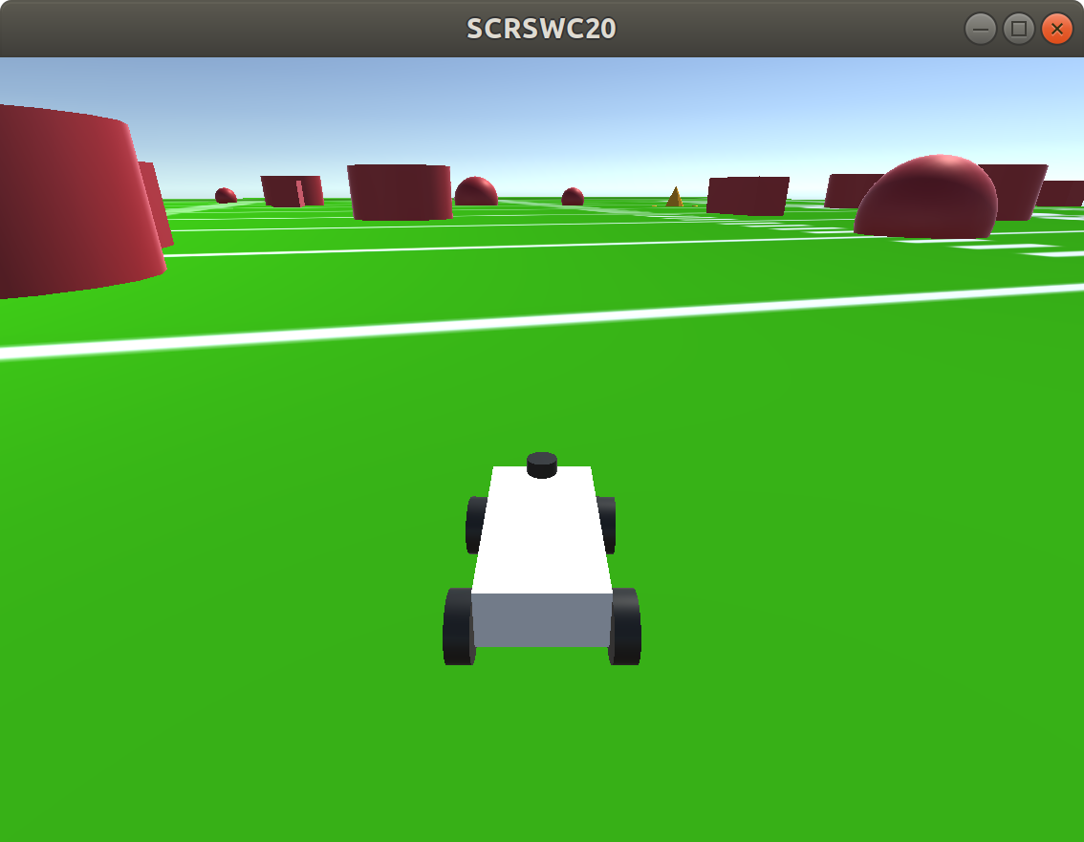
Simple Agent
Uses waypoint GPS and raw current GPS to determine the desired global heading to follow. Uses a standard control structure, proportional-integral-derivative (PID) controller, to go from current heading to the desired. Reactively avoids obstacles with the bumper.
Serves the purpose of running the simulation and gathering data to compare ground truth, measurements, and the KF state.
Gives benchmark performance to try and beat with the KF (sometimes misses waypoints or collides with obstacles).
A run of the simulator I am using. The red shapes are obstacles, and the yellow cones are waypoints. The locations of all obstacles and waypoints are randomized each run. Simulator created by Noah Zemlin for Sooner Competitive Robotics.
Notes:
Explain what PID is briefly

Slide 4
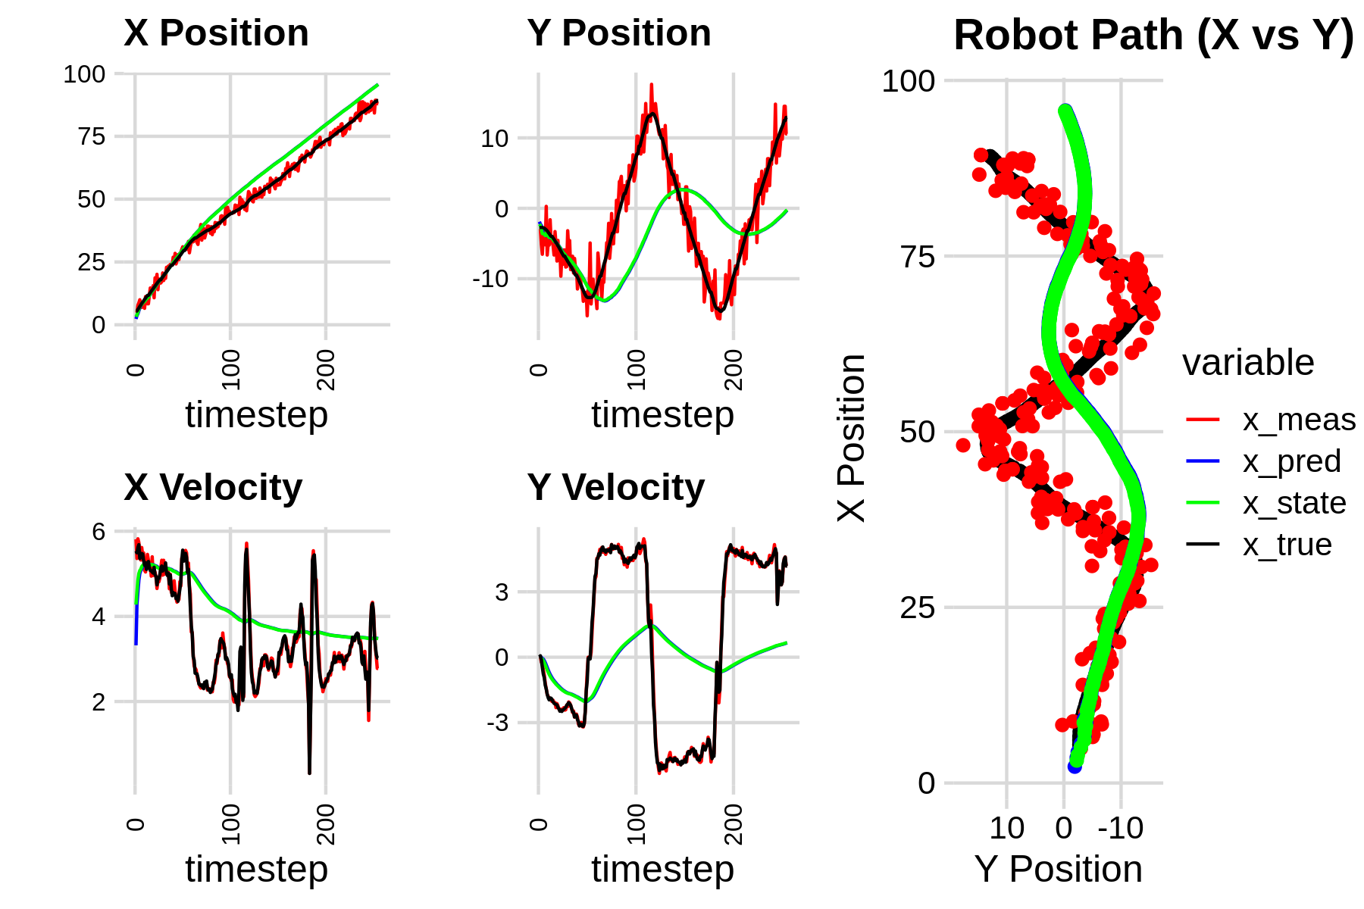
Performance With Derived Values
Shows the real path on the right, and each of our four State variables on the left. (The robot zigzags to hit the 3 waypoints and then the final goal.)
We can see the KF (green) generally follows the trend, but lags behind and is not aggressive enough to find the ground truth (black). This is because it is too confident in its own predictions and should be relying more on the measurements.
Notes:
Mention why X vs Y on track

Slide 5
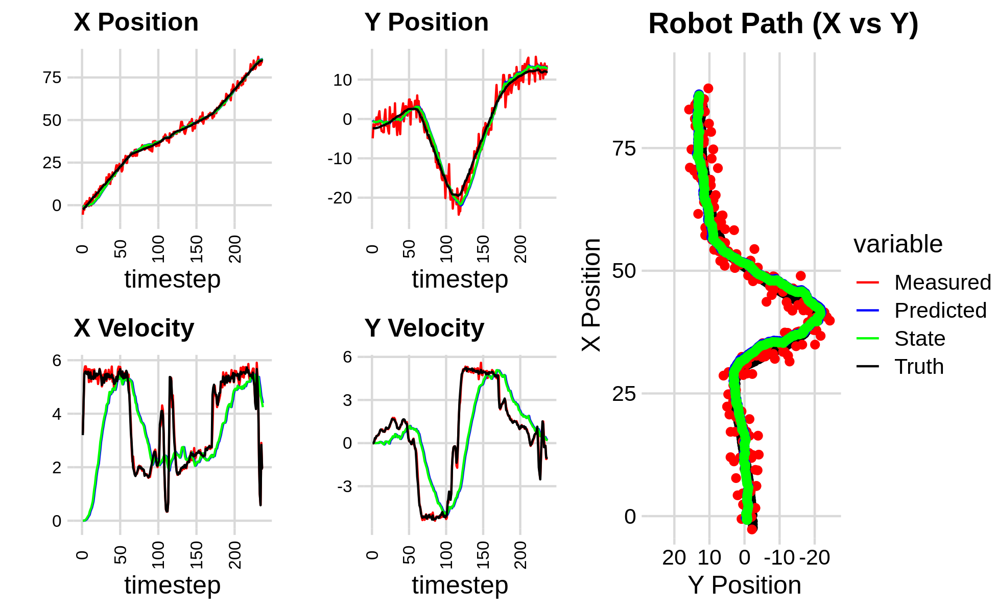
Performance After Manual Tweaking
Changing the uncertainties improved the performance. This shows the importance of getting these values right.
Our goal is to accurately follow x and y. We use a constant-velocity model, so expect inaccuracy in the velocities. To get accurate velocities, we would need to use a 6D state and assume constant accelerations.
Notes:
Mention why X vs Y on track

Slide 6
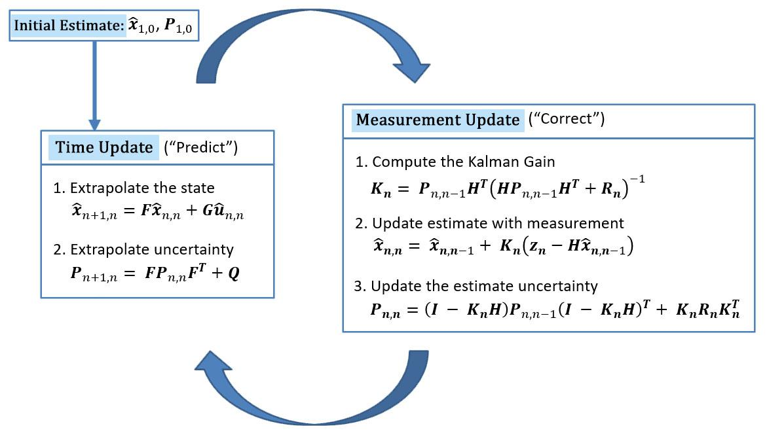
Kalman Filter Equations
We separate the KF cycle into two parts: Time Update and Measurement Update.
Make a prediction.
Compare this prediction to new measurements.
Update the state.
Shown in the figure are the most general versions of the KF equations.
Multidimensional Kalman Filter equation cycle. Modified figure from kalmanfilter.net to highlight most important focus.
Notes:
I have simplified these equations somewhat, using the fact that H is the identity and we assume optimality for the kalman gain.

Slide 7
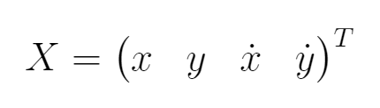
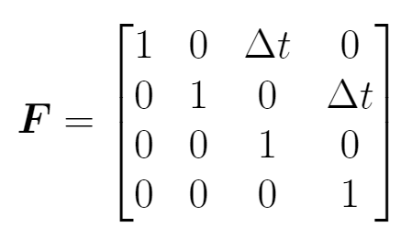
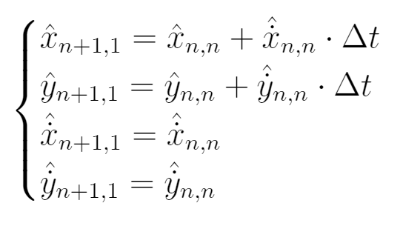
KF: State and State Transition Matrix
We use the x and y positions and velocities for our 4D State, X (in global coordinates).
The State Transition Matrix, F, is used to predict the next state. Matrix multiplication with the State applies the system of equations shown. This is our constant velocity model.

Slide 8
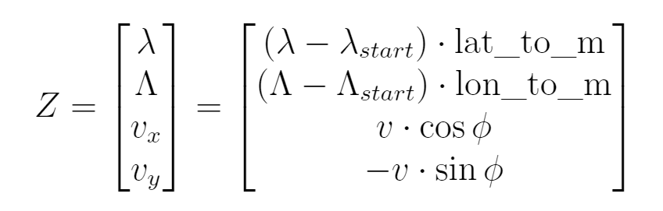
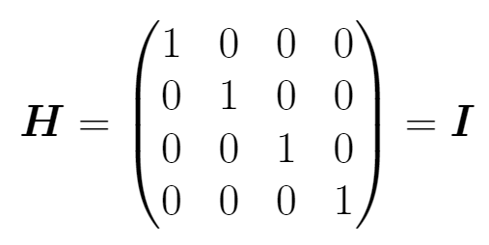
KF: Measurements and Observation Matrix
Our measurements are GPS coordinates (λ, Λ), linear velocity (v), and the current global heading (ϕ). We obtain these from our sensor suite, which includes GPS, IMU, and motor encoders. We transform these to a 4D vector, Z:
The Observation Matrix, H, relates the actual measurements, Z, to our state. Due to our choice of state variables and our transformations to Z, H is simply the identity matrix. This lets us simplify many of the KF equations.
Notes:
Z is imprecise due to the changing heading phi, but the whole filter is just converging approximations, so it will be ok; we can’t do better without moving to a nonlinear EKF. The linear GPS transforms are okay since the working area is too small; there are equations that can be used in a real application, but this is simpler and works fine for my application.

Slide 9
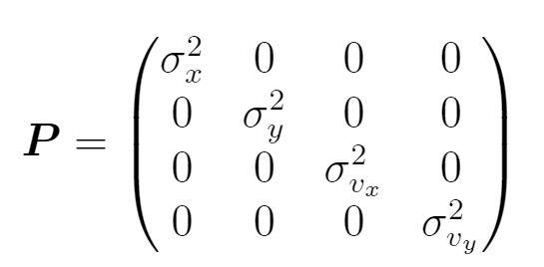
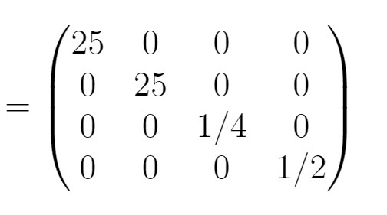
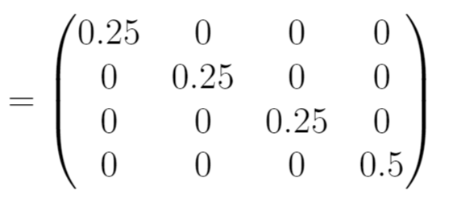
KF: Covariance (Estimate Uncertainty)
The Covariance Matrix, P, tells us the uncertainty in the KF’s own estimates. We initialize it with the variances of our measurements, and tune it as the filter runs.
Increases in Time Update and decreases in Measurement Update, so net increase if we don’t get confirmation that the estimates are good.
Process Noise, Q, and Measurement Uncertainty, R are hard to calculate exactly. Approximate as Q = R = 0.01 I. These will later be tuned by our neural network.

Slide 10
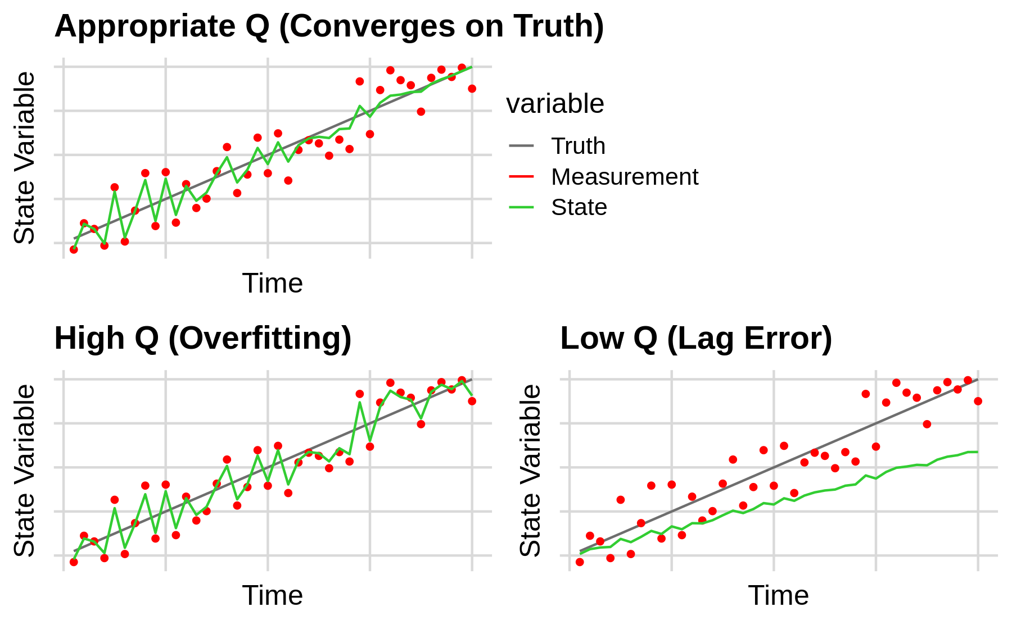
KF: The Process Noise, Q (Motivation for ML)
Represents the uncertainty in the equations and estimations themselves (the “process”).
Mimics unpredictable deviations from the Dynamic Model.
In standard KFs, this is derived beforehand and stays constant. We want to make it dynamic.
Sometimes we want either extreme temporarily depending on the situation.
Example behavior of a 1D KF with a constant dynamic model for different magnitudes of Q.
Notes:
E.g., fish tank with changing temp, but our model is constant temp.

Slide 11
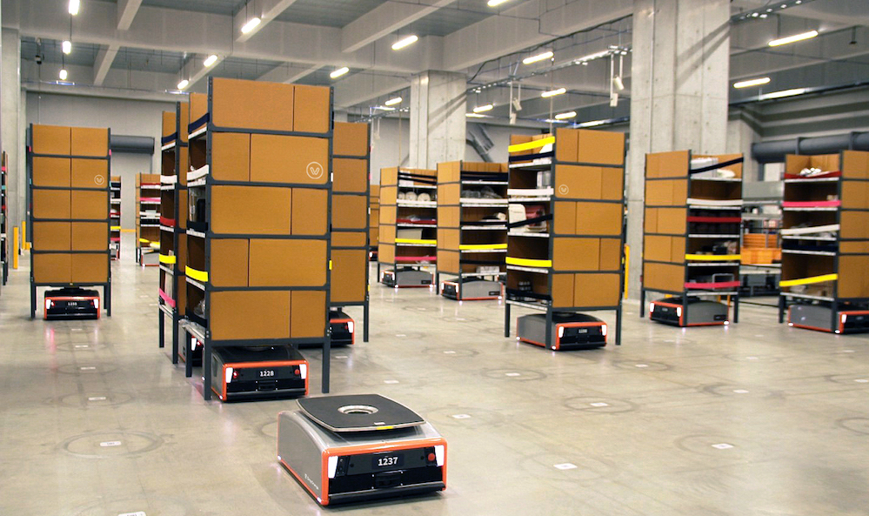
Why Are We Doing This?
More sensors utilized -> More accurate world model -> Better localization, mapping, and path planning
Health & Safety, Ethics
Better recognition of obstacles (humans)
React more quickly to changes (robust)
Robots are increasingly used in commercial applications (warehouses & grocery stores) and service industry (self-driving cars)
Economic, Environmental
Higher ability to navigate
Find the optimal path to an objective faster
Complete tasks more confidently
Saves time and money, and requires fewer “workers” and energy/fuel
Reduces failures that could result in damage to or unrecoverable machinery in the environment
Image of GreyOrange warehouse robots.
Notes:
Address the eight considerations here

Slide 12
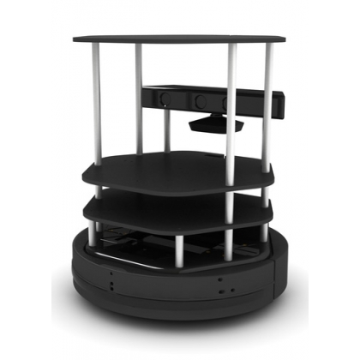
Still Left To Do (Next Semester’s Goals)
Finish up the KF & test it a lot
Include LiDAR data in KF cycle for obstacle tracking
Implement neural network to tune the KF’s process noise (Q), measurement uncertainty (R), and perhaps the initial covariance (P)
Goal: develop an agent able to finish the simulation consistently, hitting all waypoints and avoiding obstacles.
If this is achieved before the end of the spring semester, I will work to implement this with a physical robot.
A mobile “turtlebot” robot, such as one I may use for the physical implementation.
Notes:
I have access to our robots in Sooner Competitive Robotics, as well as the turtlebots that Dr. Hougen uses for his robotics class. I could also develop my own personal robot if the time allows, but the mechanical/electrical components are not the main goal with this project, since I am primarily software focused.

Slide 13
References (Thanks to Dr. Hougen and the REAL Lab!)
Kalman Filter Tutorial, Alex Becker. Last modified 2018, www.kalmanfilter.net.
Michael Nielson, Neural Networks and Deep Learning (2019), Chapter 1, www.neuralnetworksanddeeplearning.com.
Jianguo Jack Wang, Weidong Ding, and Jinling Wang, “Improving Adaptive Kalman Filter in GPS/SDINS Integration with Neural Network,” School of Surveying and Spatial Information Systems, University of New South Wales, Australia. ResearchGate, 2013, www.researchgate.net/publication/251439107_Improving_Adaptive_Kalman_Filter_in_GPSSDINS_Integration_with_Neural_Network
Justin Kleiber, IGVC Kalman Filter Derivation, Sooner Competitive Robotics, Intelligent Ground Vehicle Competition design document submission, March 16th 2020.
Noah Zemlin, SCR Software Challenge Simulator, Sooner Competitive Robotics, 2020, github.com/SoonerRobotics/SCR-SWC-20

